Slide 2
Campus Connect: Bridging Opportunities
Submitted to:
Department of Information Technology

Slide 3
Supervised by: Prof. Prashant Lakkadwala
Group Members:
Jahnavi Mandloi(0827IT211048)
Jayshree Dave (0827IT211050)
Mahee Dubey(0827IT211065)
Minakshi Soni(0827IT211069 )

Slide 4
Abstract
Campus Connect: Bridging Opportunities is an innovative platform developed to enhance and digitize the campus recruitment
process by fostering seamless interaction between students, college administrators, and recruiters. Addressing the inefficiencies
of traditional recruitment methods, this system automates critical functions such as job postings, student eligibility tracking,
and communication of recruitment-related updates. Through a centralized interface, companies can initiate recruitment drives,
which are reviewed and approved by the admin before being made accessible to eligible students. The platform ensures that
students receive timely notifications about relevant opportunities, allowing them to apply, track application statuses, and view
selection results with ease. Simultaneously, administrators benefit from comprehensive visibility and control over the
recruitment process, while recruiters gain access to filtered, qualified candidates, improving hiring efficiency. Built using Java,
HTML, CSS, JavaScript, and MySQL, Campus Connect offers a structured, transparent, and efficient recruitment ecosystem
tailored specifically for fresh graduates.

Slide 5
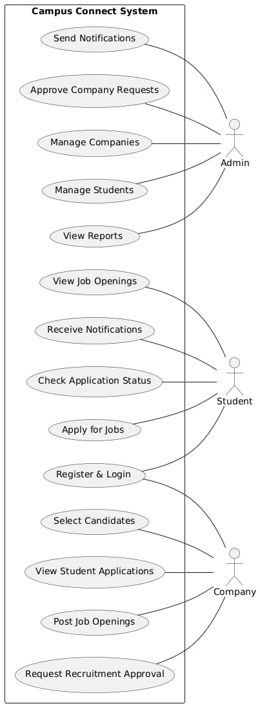
Use Case Diagram

Slide 6
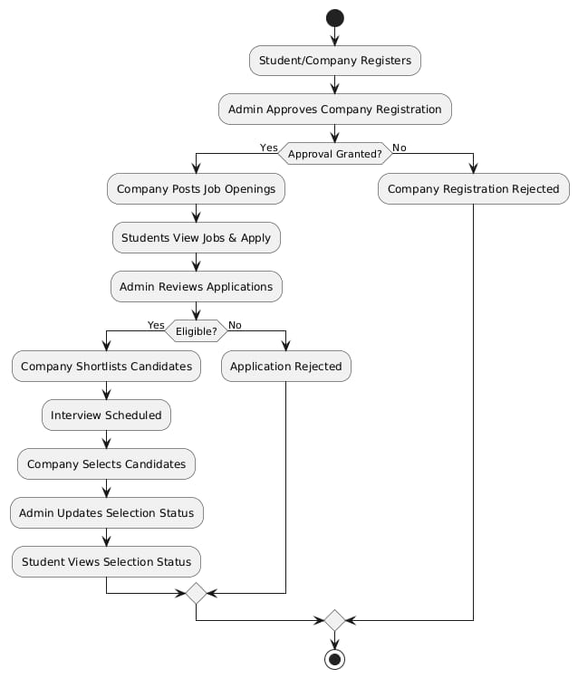
Activity diagram

Slide 7
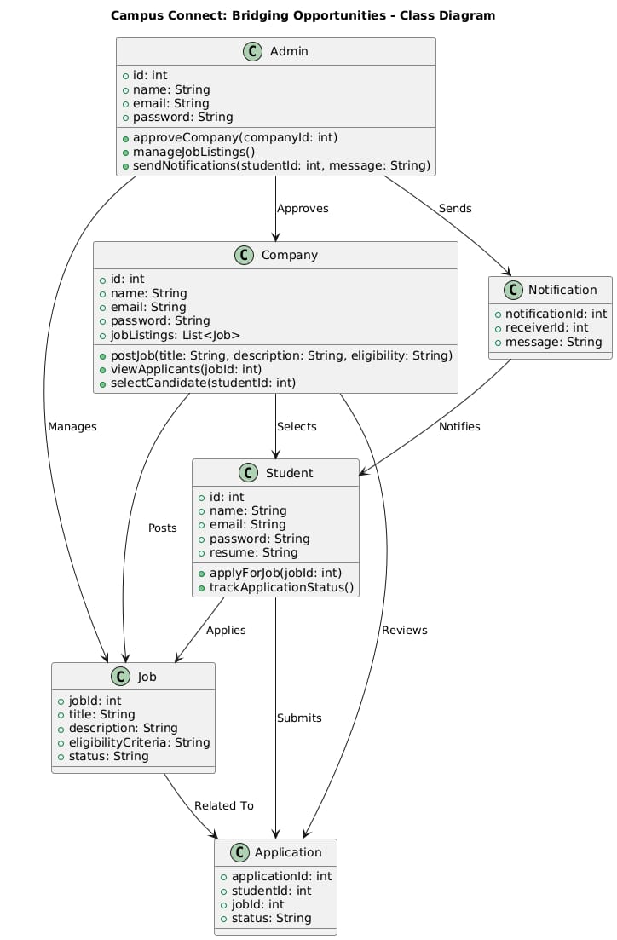
Class Diagram

Slide 8
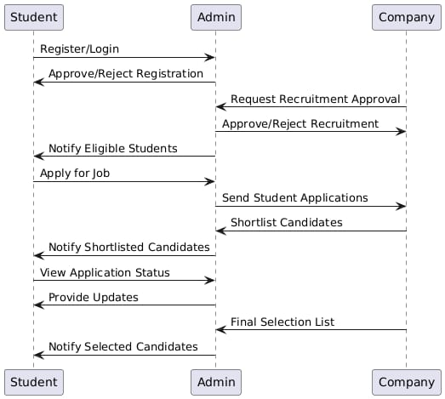
Database diagram

Slide 9


